Slide 1

Bachelor of Engineering
Project Presentation
Department of Computer Engineering
Sardar Patel Institute of Technology
(Autonomous Institute Affiliated to Mumbai University)
Munshi Nagar, Andheri(W), Mumbai-400058
2019-2020

Slide 2
A PRESENTATION ON
“Modelling Machine Learning For Analyzing Crime News”
By
Surabhi Ghankutkar (2016130022)
Neelabh Sarkar (2016130059)
Pooja Gajbhiye (2017230072)
Sanyukta Yadav (2017230081)
Under the guidance of
Dr. Dhananjay R. Kalbande
Ms. Nida Bakereywala

Slide 3


Introduction
Crime analysis
Crime analysis is a systematic way of identifying and analyzing patterns and trends in crime
Why crime analysis?
To assist police agencies to deploy resources in a more effective manner
To assist detectives in identifying suspects
To acquaint individuals about the crimes happening in their environment
Modelling Machine Learning For Analyzing Crime News

Slide 4

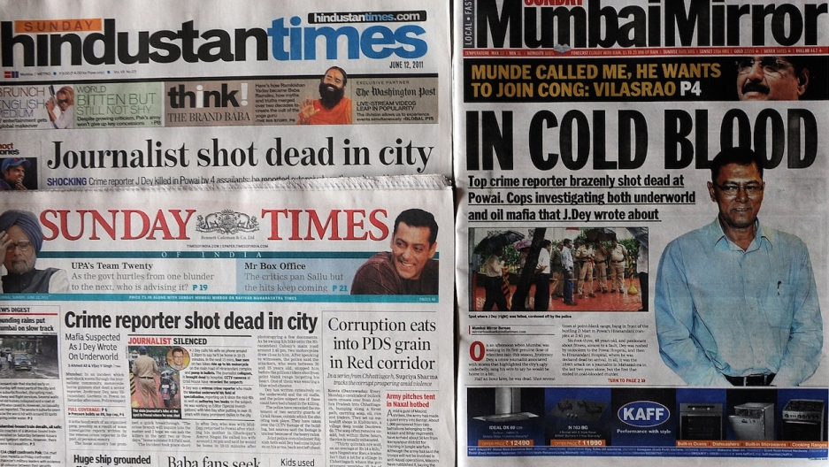
Introduction
Why crime analysis using newspaper?
Newspaper is a huge source of information
It is read by most people
It contains information in an unstructured form
If this information is processed and analyzed properly it can serve as a great asset
Modelling Machine Learning For Analyzing Crime News

Slide 5
Motivations
The crime rate in India is growing at a rapid pace.
The types of crimes committed in India is seen to be highly complex and have many relevant details.
Most crimes require in-depth analysis which is very difficult to perform on short notice.
Law enforcement agencies often have to deal with multiple crimes simultaneously and need information to be provided in a quick and efficient manner.
If a system for analyzing crime through online news papers is deployed effectively, it could reduce further incidences of crimes and help the citizens.
Modelling Machine Learning For Analyzing Crime News

Slide 6
Objectives
To give accurate analysis of real time data from online newspaper articles.
Accessible and efficient to any user interested in crime analysis.
Modelling Machine Learning For Analyzing Crime News

Slide 7
Literature Survey
PAPERNO. | PAPER DETAILS | OBJECTIVE | METHODS USED | OBSERVATION
1 | Crime Analytics: Analysis of Crime Through Newspaper Articles ,2015 | Web based crime analysis system. Sri Lankan English newspapers are given as source for crime details. By using preprocessed data, crime operations are performed and results are displayed using web based GUI. | 1. Web crawling 2. SVM based classifier 3.GATE(General Architecture for Text Engineering) 4. ANNIE 5. LingPipe 6. OpenNLP 7. JavaScript and AJAX | The end user is provided with a map which shows the colored region depending upon the crime. Crime comparison pie chart and crime pattern visualization time series is used to compare crimes and show the pattern of the crime depending upon the frequency.
2 | Crime Pattern Detection, Analysis & Prediction, 2017 | Creation of model for predicting crime rate in various states to help local police stations in crime suppression. | 1. Apriori Association Mining 2. k-Means Clustering 3. Naive Bayes 4. Classification Correlation & Regression | Calculates the no of crime done in the state and for every no of crime cases how many people are convicted. (Eg In 10 rape cases, 3 people are convicted)
3 | Crime News Analysis: Location and Story Detection, 2017 | Provide the definite information about a news whether it is a crime related news or not, crime location, similarity and grouping crime news as stories based on a crime news | 1. Web crawling 2. Named Entity Recognition 3. Support Vector Machine 4. Natural Language Toolkit | Top location names by the number of crime occurred are ranked and listed. Grouping similar news as a story based on a crime news
Modelling Machine Learning For Analyzing Crime News

Slide 8
PAPERNO. | PAPER DETAILS | OBJECTIVE | METHODS USED | OBSERVATION
4 | Cluster based Zoning of Crime Info, 2017 | Cluster analysis by using k-means clustering algorithm on criminal dataset of India. | 1. Weak classifier 2. K means clustering | The states are classified in high, low and medium crime zones. Male and female crime information is also classified.
5 | Crime Analysis using K-means Clustering, 2017 | Qualitative and quantitative data mining approach to analyze the crime which entails theft, homicide and various drug offences including suspicious activities, noise complaints and burglar alarm system. | 1. RapidMiner 2. Data cleaning 3. Data selection 4. Data transformation 5. K-means | Using k-means clustering data mining approach on a crime dataset from New South Wales region of Australia, crime rates of each type of crimes and cities with high crime rates have been found.
6 | Forecasting of Annual Crime Rate in India: A Case Study, 2018 | Forecasting annual crime rate in India of past few years. | 1. Box-Jenkins Model 2. Exponential Smoothing 3. ARIMA (Auto Regression Integrated Moving Average) Model. | It is observed from the paper that time series model can be applied for crime forecasting.
7 | Crime Prediction and Forecasting in Tamilnadu using Clustering Approaches, 2016 | Predicting crimes and identifying criminals in certain geographic locations. | 1. KNN classification 2. K-Means clustering 3. Agglomerative hierarchical clustering 4. DBSCAN clustering | Hotspots have been found, with different colors depending on the number of crimes that occured. The clusters have acceptable accuracy and precision.
Modelling Machine Learning For Analyzing Crime News

Slide 9
PAPER NO. | PAPER DETAILS | OBJECTIVE | METHODS USED | OBSERVATION
8 | An Overview on Crime Prediction Methods, 2017 | Crime analysis tool to analyse the crime patterns qualitatively and quantitatively using official records. | 1. Support Vector Machine (SVM) 2. Fuzzy Theory 3. Artificial Neural Network (ANN) 4. Multivariate Time Series | In the context of crime prediction, Artificial Neural Networks are highly accurate and require comparatively less time.
9 | Crime Analysis and Mapping through Online Newspapers: A Survey, 2016 | A web based crime analysis system on the basis of online newspapers. | 1. Web Crawler 2. SVM 3. GATE (General Architecture for Text Engineering) | Various crime analysis methods like hot spot detection, crime comparison, and crime pattern visualization have been developed.
10 | Exploring Transfer Learning for Crime Prediction, 2017 | A novel transfer learning framework to integrate crime related features from cross domain datasets and model spatio-temporal patterns for crime. | 1. Transfer Learning | A novel framework, which captures temporal-spatial patterns and leverages transfer learning for crime prediction. Spatial Temporal Framework leverages cross-domain urban datasets, e.g., public security data, meteorological data, point of interests (POIs), human mobility data and 311 complaint data.
11 | Crime Prediction and Analysis Using Machine Learning, 2018 | To predict different types of crime using different machine learning algorithms. | 1. K Neighbors Classifier 2. GaussianNB 3. SVC 4. Decision Tree Classifier 5. MultinomialNB | Different algorithms were used to predict the type of crime from a dataset available from kaggle.
Modelling Machine Learning For Analyzing Crime News

Slide 10
PAPER NO. | PAPER DETAILS | OBJECTIVE | METHODS USED | OBSERVATION
12 | A review: Crime analysis using data mining techniques and algorithms, 2017 | A review of different data mining techniques | 1. Z-CrimeTool 2. D3 Algorithm 3. Hidden link detection algorithm 4. Naïve Bayes Classifiers 5. Apriorialgorithm | ID3 algorithm had more effective classification rules. Naïve Bayes had an accuracy of more than 90%
13 | Using Machine Learning to Assist Crime Prevention. 2017 | A model for crime prediction and prevention | 1. Deep Learning 2. Random Forest 3. Naïve Bayes | Hotspots are generated and Deep Learning as the best accuracy, precision, recall and F-measure
14 | Crime Analysis Through Machine Learning, 2018 | A crime prection model based on machine learning algorithms | 1. K Nearest Neighbour 2. Boosted Decision Tree | The model has an accuracy of 39-44% which
Modelling Machine Learning For Analyzing Crime News

Slide 11
Gap/Issue Identified
The data that is utilized by the current system is in previously recorded data. It is not extracted directly from online resources in real time.
The data taken as input in the existing research comes from databases and is already pre-processed.
Through the literature survey we couldn't observe any existing systems in India that perform crime analysis on online newspapers.
We observed that crime analysis is done based on location, type and frequency and based on this they have assigned ranks crime location. No crime type has been analyzed individually.
Modelling Machine Learning For Analyzing Crime News

Slide 12
Problem Statement
To design a machine learning model for analysis of newspaper for classifying the news into crime and non-crime.
Modelling Machine Learning For Analyzing Crime News

Slide 13
Contribution
The implemented system allows users to perform analysis on the real-time crime data in India and then stores it in a database.
Since the data is retrieved from recently published news paper articles, it has more relevance to the current environment.
This system also structures the raw data. Thus it will perform better than conventional solutions which use databases that are often outdated.
Modelling Machine Learning For Analyzing Crime News

Slide 14
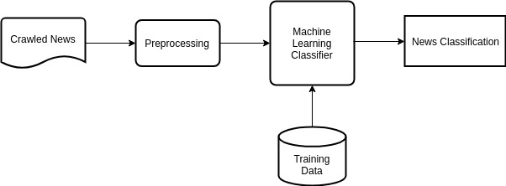
System Design/ Methodology/ Algorithm
Web crawler: Parse online newspaper articles and extract the news.
Preprocessing: Performing operations such as tokenization, lemmatization on the crawled news.
Classifier: ML classifier that is trained and then tested on crawled news.
News classification: Obtain the classification of the news into crime and non crime using classification algorithm.
Modelling Machine Learning For Analyzing Crime News

Slide 15
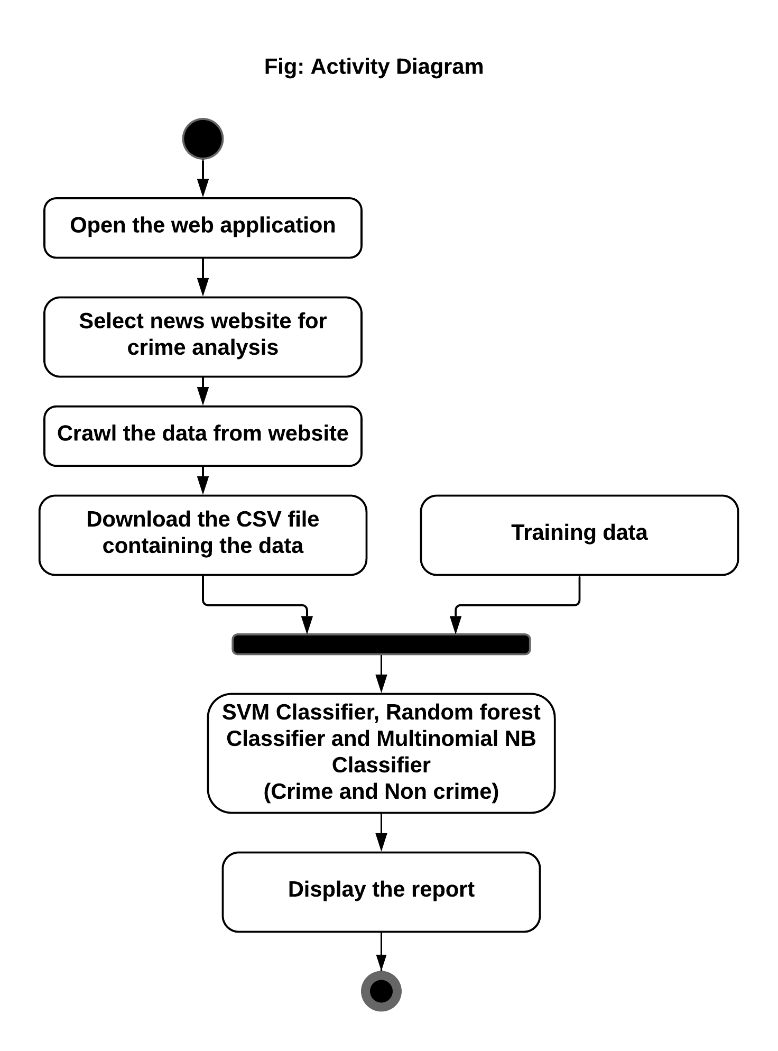

Slide 16
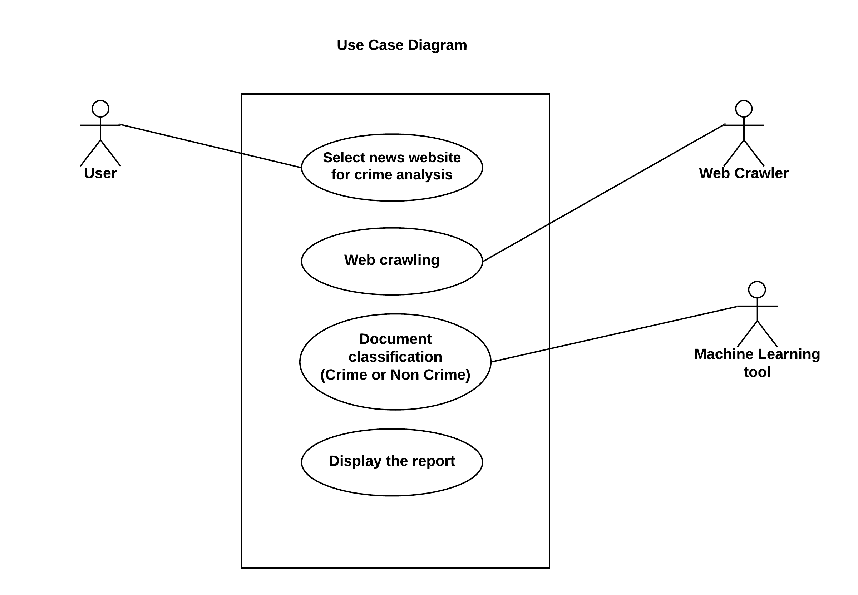

Slide 17
Implementations
Dataset and Data Preprocessing:
The underlying machine learning model is trained using 6700 news records taken from the News Category dataset.
The News Category dataset contains around 200k news from the year 2012 to 2018 taken from HuffPost.
HuffPost is an American news and opinion website and blog.
We took 3400 crime news records and around other 3300 records of other category of news.
The training dataset consisted of the following attributes: headline, category(crime or non-crime), date.

Slide 18
Implementations
Base Model:
Three classifiers: Random Forest, SVM( Support Vector Machine) and MultinomialNB, have been implemented.
Extraction of headings from the training dataset and tokenize it into words using nltk library functions.
Lemmatization is performed on the tokenized words and stop words are also removed.
Modelling Machine Learning For Analyzing Crime News

Slide 19
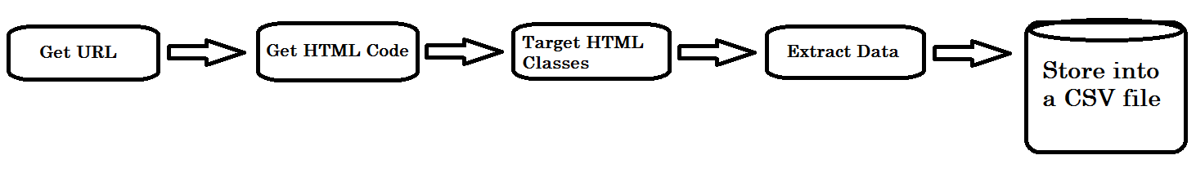
Implementations
Web Crawler
Web Crawler is implemented in python programming language, using libraries like BeautifulSoup4 and lxml.
BeautifulSoup4 requires two parameters, the source, and the parser type (lxml)
Headlines, summary and news are extracted by the webe crawler and stored in a CSV file.
Modelling Machine Learning For Analyzing Crime News

Slide 20
Implementations
Real Time Classification :
The crawled news from the online sites is used as an input to the base model for making predictions.
Random Forest, SVM and Multinomial NB classifiers were used to classify the crawled news into crime and non-crime.

Slide 21

Results and Discussions
Following table shows the accuracy percentage for cross-validation dataset.
Modelling Machine Learning For Analyzing Crime News

Slide 22
Results and Discussions
The predicted output obtained from the classification of crawled news was manually reviewed.
Here sometimes Support Vector Machine classifiers gave a better accuracy than Multinomial NB and Random Forest classifier.
The model sometimes wrongly classifies the non-crime news into crime due to occurrence of certain type of words such as 'die, death' in the news.

Slide 23
Conclusion
Thus the proposed system could be beneficial for the common people, policemen, crime agencies, law-enforcement agencies.
Using NLP techniques we can better extract the useful information from the newspapers.
This could allow for a broader understanding of crime in the context of Indian newspapers.
Modelling Machine Learning For Analyzing Crime News

Slide 24
Future Scope
Collecting the crawled news data for over a period of time (months/year) and analyzing it to find how the crime rate varies for a particular location.
Datasets containing different crime types with features could be used. Using NLP techniques like entity extraction can be used to classify crime types in the news.
Modelling Machine Learning For Analyzing Crime News

Slide 25
References
[1] Jayaweera, C. Sajeewa, S. Liyanage, T. Wijewardane, I. Perera and A. Wijayasiri, "Crime analytics: Analysis of crimes through newspaper articles," 2015 Moratuwa Engineering Research Conference (MERCon), Moratuwa, 2015, pp. 277-282. doi: 10.1109/MERCon.2015.7112359
[2] S. Yadav, M. Timbadia, A. Yadav, R. Vishwakarma and N. Yadav, "Crime pattern detection, analysis & prediction," 2017 International conference of Electronics, Communication and Aerospace Technology (ICECA), Coimbatore, 2017, pp. 225-230. doi: 10.1109/ICECA.2017.8203676
[3] M. Hassan and M. Z. Rahman, "Crime news analysis: Location and story detection," 2017 20th International Conference of Computer and Information Technology (ICCIT), Dhaka, 2017, pp. 1-6. doi: 10.1109/ICCITECHN.2017.8281798
[4] L. S. Thota, M. Alalyan, A. A. Khalid, F. Fathima, S. B. Changalasetty and M. Shiblee, "Cluster based zoning of crime info," 2017 2nd International Conference on Anti-Cyber Crimes (ICACC), Abha, 2017, pp. 87-92. doi: 10.1109/Anti-Cybercrime.2017.7905269
[5] A. Joshi, A. S. Sabitha and T. Choudhury, "Crime Analysis Using K-Means Clustering," 2017 3rd International Conference on Computational Intelligence and Networks (CINE), Odisha, 2017, pp. 33-39. doi: 10.1109/CINE.2017.23
[6] M. Kumar et al., "Forecasting of Annual Crime Rate in India: A case Study," 2018 International Conference on Advances in Computing, Communications and Informatics (ICACCI), Bangalore, 2018, pp. 2087-2092. doi: 10.1109/ICACCI.2018.8554422
[7] S. Sivaranjani, S. Sivakumari and M. Aasha, "Crime prediction and forecasting in Tamilnadu using clustering approaches," 2016 International Conference on Emerging Technological Trends (ICETT), Kollam, 2016, pp. 1-6. doi: 10.1109/ICETT.2016.7873764
[8] N. H. M. Shamsuddin, N. A. Ali and R. Alwee, "An overview on crime prediction methods," 2017 6th ICT International Student Project Conference (ICT-ISPC), Skudai, 2017, pp. 1-5. doi: 10.1109/ICT-ISPC.2017.8075335
Modelling Machine Learning For Analyzing Crime News

Slide 26
References
[9] D. V. Rohini and P. Isakki, "Crime analysis and mapping through online newspapers: A survey," 2016 International Conference on Computing Technologies and Intelligent Data Engineering (ICCTIDE'16), Kovilpatti, 2016, pp. 1-4. doi: 0.1109/ICCTIDE.2016.7725331
[10] X. Zhao and J. Tang, "Exploring Transfer Learning for Crime Prediction," 2017 IEEE International Conference on Data Mining Workshops (ICDMW), New Orleans, LA, 2017, pp. 1158-1159. doi: 10.1109/ICDMW.2017.165
[11] Alkesh Bharati, Dr Sarvanaguru RA.K, Crime Prediction and Analysis Using Machine Learning, International Research Journal of Engineering and Technology (IRJET) Volume: 05 Issue: 09 | Sep 2018
[12] C. Chauhan and S. Sehgal, "A review: Crime analysis using data mining techniques and algorithms," 2017 International Conference on Computing, Communication and Automation (ICCCA), Greater Noida, 2017, pp. 21-25. doi: 10.1109/CCAA.2017.8229823
[13] Y. Lin, T. Chen and L. Yu, "Using Machine Learning to Assist Crime Prevention," 2017 6th IIAI International Congress on Advanced Applied Informatics (IIAI-AAI), Hamamatsu, 2017, pp. 1029-1030. doi: 10.1109/IIAI-AAI.2017.46
[14] S. Kim, P. Joshi, P. S. Kalsi and P. Taheri, "Crime Analysis Through Machine Learning," 2018 IEEE 9th Annual Information Technology, Electronics and Mobile Communication Conference (IEMCON), Vancouver, BC, 2018, pp. 415-420. doi: 10.1109/IEMCON.2018.8614828
Modelling Machine Learning For Analyzing Crime News

Slide 27
THANK YOU

